Slide 1

NAÏVE BAYES CLASSIFIER.

Slide 2

TITLE
Naïve bayes classifier
Working
Advantages& disadvantages
Application
Types of naïve bayes
Gaussian
Multinomial
Bernoulli

Slide 3
NAÏVE BAYES Classifier
Based on Bayes theorem
The Naïve Bayes classifier is a supervised machine learning algorithm.
It is a probabilistic classifier, which means it predicts on the basis of the probability of an object.
It is mainly used in text classification that includes a high-dimensional training dataset.
Examples, are spam filtration, Sentimental analysis, and classifying articles.
The Naive Bayes classifier is "naive" because it assumes that the presence or absence of a particular feature is independent of the presence or absence of any other feature. This is a simplifying assumption that allows the algorithm to work efficiently and effectively in many cases.
Bayes comes from the Bayes Theorem

Slide 4

Basically, we are trying to find probability of event A, given the event B is true. Event B is also termed as evidence.
P(A) is the priori of A (the prior probability, i.e. Probability of event before evidence is seen). The evidence is an attribute value of an unknown instance(here, it is event B).
P(A|B) is a posteriori probability of B, i.e. probability of event after evidence is seen.

Slide 5
Working of naïve Bayes classifier
Convert the given dataset into frequency tables.
Generate Likelihood table by finding the probabilities of given features.
Now, use Bayes theorem to calculate the posterior probability.

Slide 6
ADVANTAGES & DISADVANTAGES
ADVANTAGES:
DISADVANTAGES:
Less complex: Compared to other classifiers, It is considered a simpler classifier since the parameters are easier to estimate. As a result, it’s one of the first algorithms learned within data science and machine learning courses.
Scales well: Compared to logistic regression, Naïve Bayes is considered a fast and efficient classifier that is fairly accurate when the conditional independence assumption holds. It also has low storage requirements.
Can handle high-dimensional data: Use cases, such document classification, can have a high number of dimensions, which can be difficult for other classifiers to manage.
Subject to Zero frequency: Zero frequency occurs when a categorical variable does not exist within the training set. For example, imagine that we’re trying to find the maximum likelihood estimator for the word, “sir” given class “spam”, but the word, “sir” doesn’t exist in the training data. The probability in this case would zero, and since this classifier multiplies all the conditional probabilities together, this also means that posterior probability will be zero. To avoid this issue, laplace smoothing can be leveraged.
Unrealistic core assumption: While the conditional independence assumption overall performs well, the assumption does not always hold, leading to incorrect classifications.

Slide 7
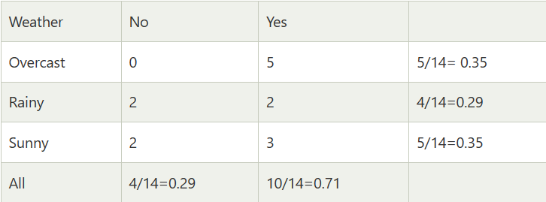
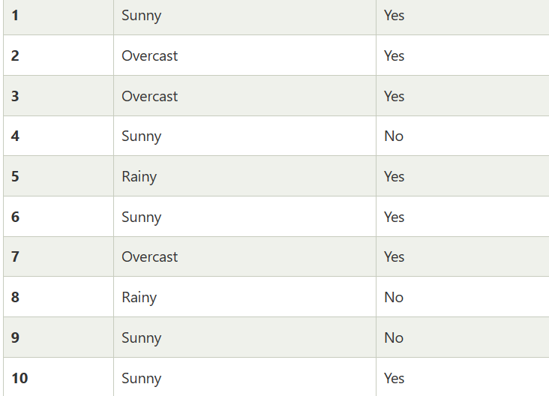
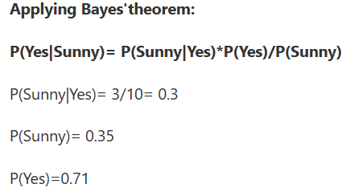


Problem: If the weather is sunny, then the Player should play or not?
Solution: To solve this, first consider the below dataset:
Frequency table

Slide 8

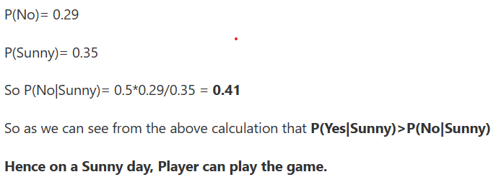

Slide 9
application
Naïve bayes classifier.
It is used for Credit Scoring.
It is used in medical data classification.
It can be used in real-time predictions because Naïve Bayes Classifier is an eager learner.
It is used in Text classification such as Spam filtering and Sentiment analysis.

Slide 10

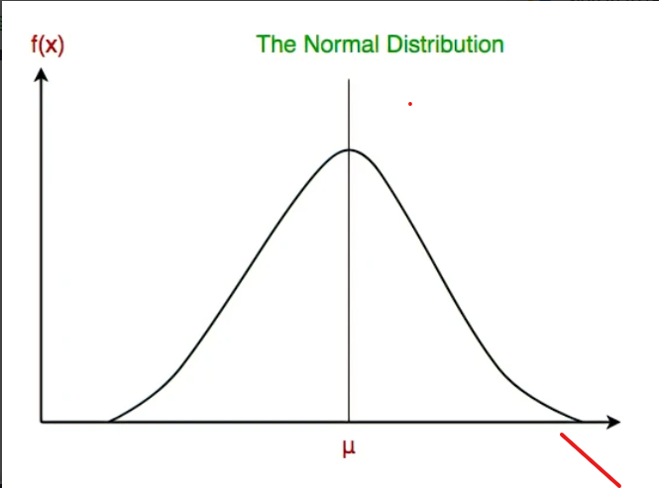
Types of Naïve Bayes Model
1. Gaussian: The Gaussian model assumes that features follow a normal distribution. This means if predictors take continuous values instead of discrete, then the model assumes that these values are sampled from the Gaussian distribution.

Slide 11
2.Multinomial: The Multinomial Naïve Bayes classifier is used when the data is multinomial distributed. It is primarily used for document classification problems, it means a particular document belongs to which category such as Sports, Politics, education, etc. The classifier uses the frequency of words for the predictors.

Slide 12
3.Bernoulli: The Bernoulli classifier works similar to the Multinomial classifier, but the predictor variables are the independent Booleans variables. Such as if a particular word is present or not in a document. This model is also famous for document classification tasks.

Slide 13

Thankyou

